Slide 1
WORLD OF LASERS
Red Laser Components

Slide 2
LASER
A laser is effectively a machine that makes billions of atoms pump out trillions of photons (light particles) all at once.
So they line up to form a really...
...concentrated light beam.
x
x

Slide 3
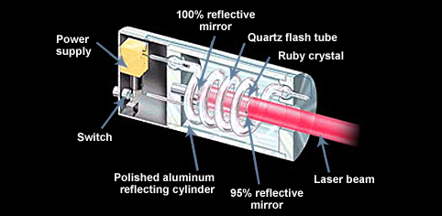
RED LASER
A red laser contains a long crystal made of ruby with a flash tube wrapped around it.

Slide 4
RED LASER
The flash tube looks a bit like a fluorescent strip light, only it's coiled around the ruby crystal and it flashes every so often like a camera's flash gun.

Slide 5
?
WELL DONE!
Move on to the next topic of
the How Laser Work area!
HOW THESE COMPONENTS
MAKE LASER LIGHT?

